Slide 1

Monitoring
Oil & TSS in Water
Canty Process Technology
JM Canty, Inc. · Buffalo, New York · Phone: (716) 625-4227 | JM Canty, Ltd. · Dublin, Ireland · Phone: +353 (1) 882-9621

Slide 2
Oil & Solids in Water - Background
Water Analysis
Oil in Water
Environmental
TSS in Water
Process Control & Optimisation
Process Control & Optimisation
Separation Equipment / Chemical Performance Analysis
30ppm Dispersed Oil in Water
Separation Equipment Performance Analysis
WFI – TSS Size & Concentration Analysis to Avoid Well Plugging
Well Formation Studies – Core Sample Testing
JM Canty, Inc. · Buffalo, New York · Phone: (716) 625-4227 | JM Canty, Ltd. · Dublin, Ireland · Phone: +353 (1) 882-9621

Slide 3
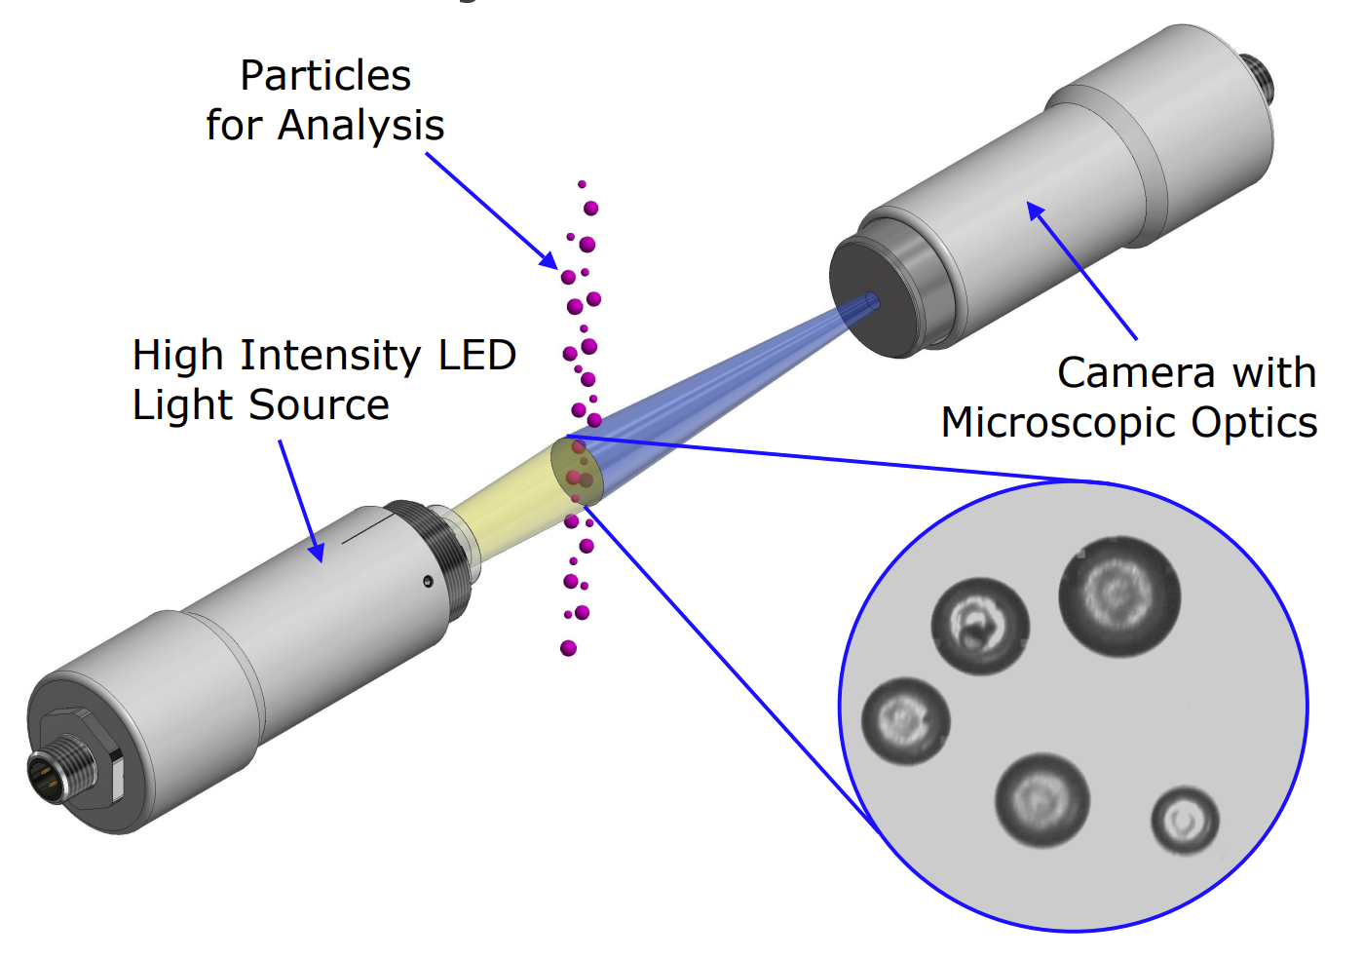
Vision Based Particle Analysis Basic Principle
JM Canty’s vision based technique works on the basic principle of presenting the fluid between a high intensity light source, and microscopic camera
The captured images are then sent to CantyVision Software for analysis, where the suspended “particles” (oil or water, solids, gas bubbles etc.) are measured for a number of different parameters to provide size, shape and concentration data
JM Canty, Inc. · Buffalo, New York · Phone: (716) 625-4227 | JM Canty, Ltd. · Dublin, Ireland · Phone: +353 (1) 882-9621

Slide 4
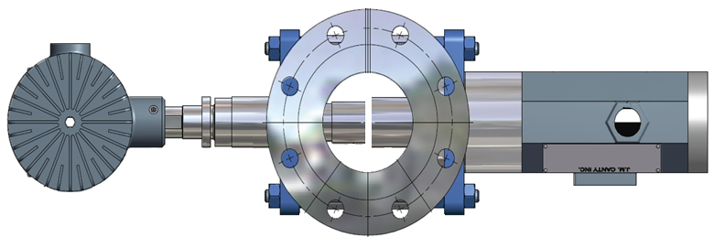
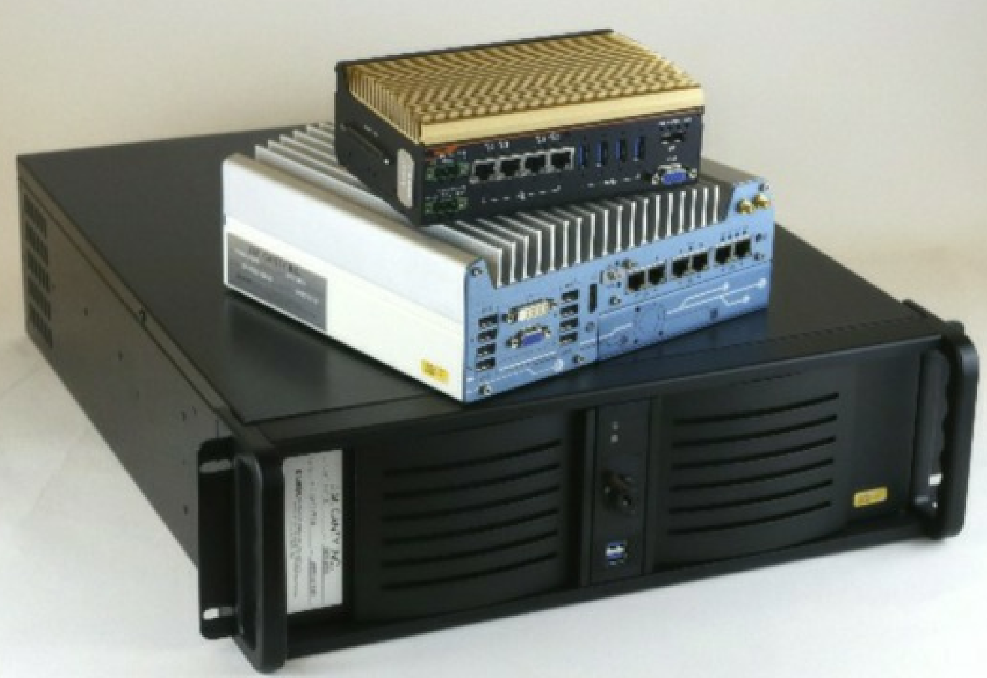
Hardware – Image Retrieval and Analysis
4 Primary Hardware Components Required For High Quality Image Analysis:
Camera
Light
Flow Cell
Vector Control Module
(VCM)
JM Canty, Inc. · Buffalo, New York · Phone: (716) 625-4227 | JM Canty, Ltd. · Dublin, Ireland · Phone: +353 (1) 882-9621

Slide 5
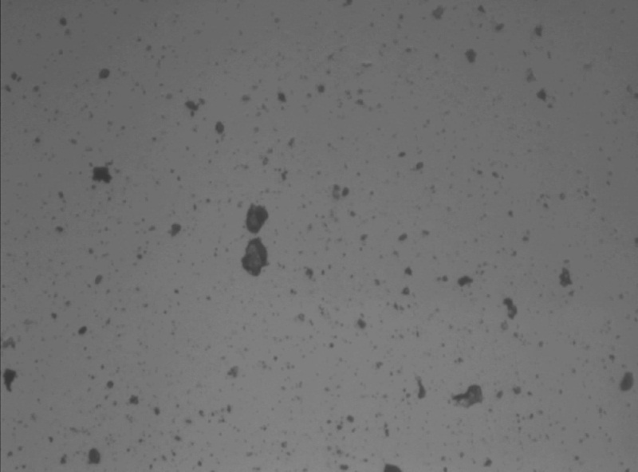
Hardware – Image Retrieval
Camera
Gigabit Ethernet technology for optimum image retrieval
4112 x 2176 Pixel Array configurable to 0.23µm per Pixel Resolution
Particle / Droplet Size to 0.7µm
Simple RJ45 Network Connection to Control PC
Sand in Water
JM Canty, Inc. · Buffalo, New York · Phone: (716) 625-4227 | JM Canty, Ltd. · Dublin, Ireland · Phone: +353 (1) 882-9621

Slide 6
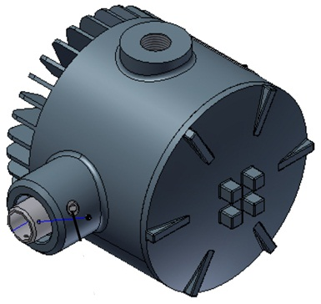
Hardware – Image Retrieval
Lighting System
High flow rates inline require an increased shutter speed and so an increased amount of light to capture particulate in “freeze frame” in order to perform software analysis
High Intensity LED Light Source
5+ Years Continuous Operation
Flow velocity up to 5m/s
JM Canty, Inc. · Buffalo, New York · Phone: (716) 625-4227 | JM Canty, Ltd. · Dublin, Ireland · Phone: +353 (1) 882-9621

Slide 7
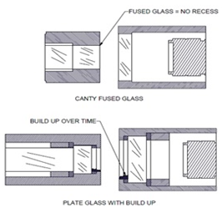
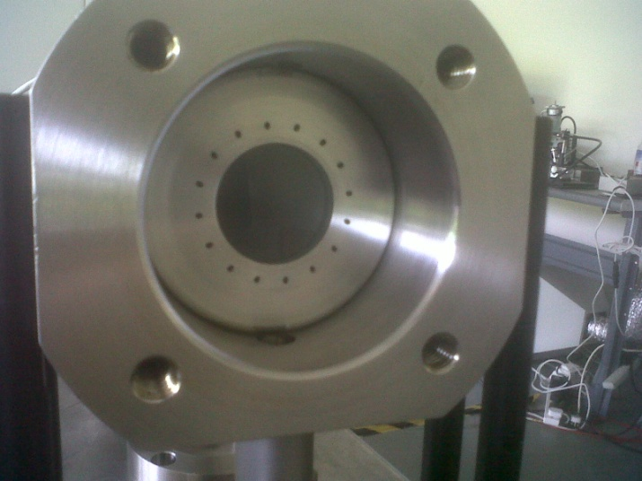
Hardware – Image Retrieval
Fused Glass Flow Path
Fused one piece construction with no recesses or steps where product can adhere to and build up
Pressures to 600 BAR
Integral Jet Spray Ring
Adjustable Gap Size dependent on sample present
JM Canty, Inc. · Buffalo, New York · Phone: (716) 625-4227 | JM Canty, Ltd. · Dublin, Ireland · Phone: +353 (1) 882-9621

Slide 8
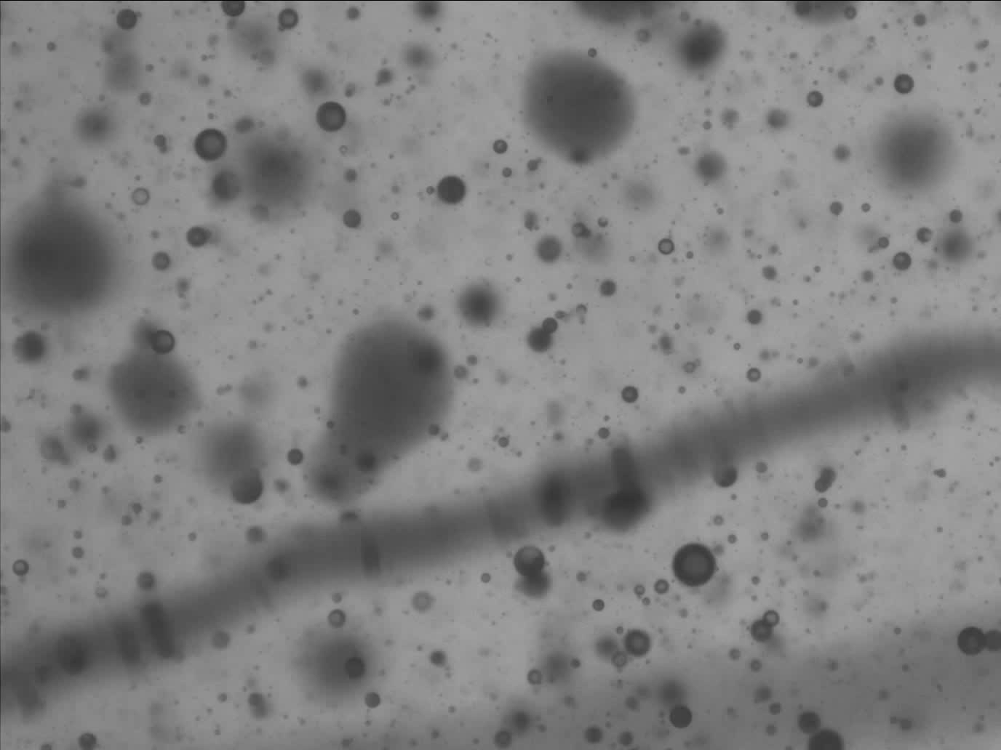
JM Canty, Inc. · Buffalo, New York · Phone: (716) 625-4227 | JM Canty, Ltd. · Dublin, Ireland · Phone: +353 (1) 882-9621

Slide 9
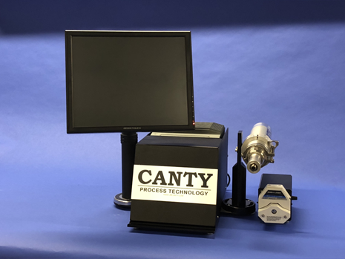
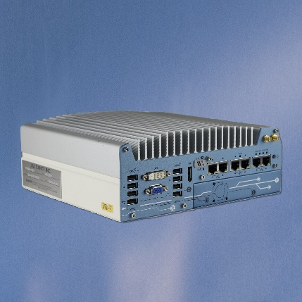
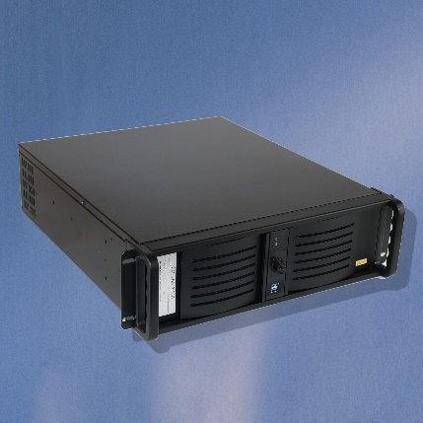
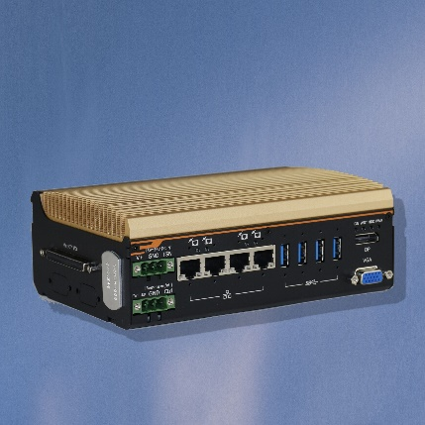
Hardware – Image Analysis
Vector Control Module (VCM)
Ease of use and installation
Multiple analyzers from one VCM
Multiple outputs to interface with
Remote Support Functionality
JM Canty, Inc. · Buffalo, New York · Phone: (716) 625-4227 | JM Canty, Ltd. · Dublin, Ireland · Phone: +353 (1) 882-9621

Slide 10
Installations
Many different types of installations to adapt to where analysis is needed:
      Inline
      At-Line
      Skid
      Cart
      Portable
      Transportable
      Lab
JM Canty, Inc. · Buffalo, New York · Phone: (716) 625-4227 | JM Canty, Ltd. · Dublin, Ireland · Phone: +353 (1) 882-9621

Slide 11
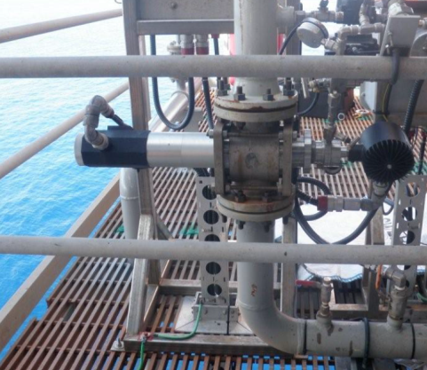
Installations – In-line
Directly in process
Acts as a spool piece in the pipe
Typically up to 2” lines
Can also be mounted on fast loop bypass line for larger process lines
JM Canty, Inc. · Buffalo, New York · Phone: (716) 625-4227 | JM Canty, Ltd. · Dublin, Ireland · Phone: +353 (1) 882-9621

Slide 12
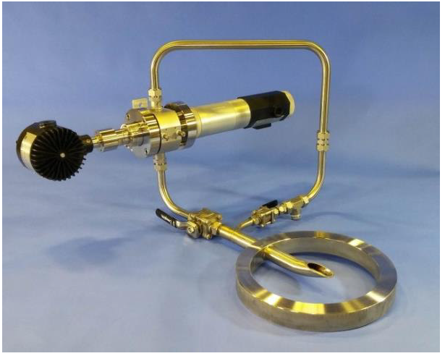
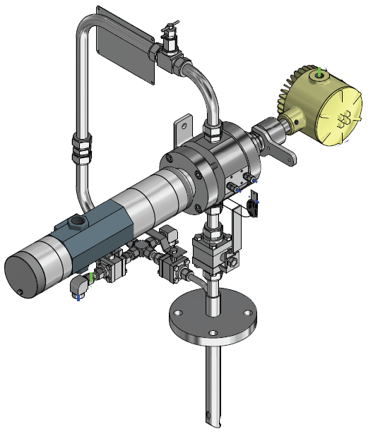
Installations – At-Line
Short Loop Sampler
  Wafer or flange models
Ability to isolate from process
One take out and return line
Line size 3”+
JM Canty, Inc. · Buffalo, New York · Phone: (716) 625-4227 | JM Canty, Ltd. · Dublin, Ireland · Phone: +353 (1) 882-9621

Slide 13
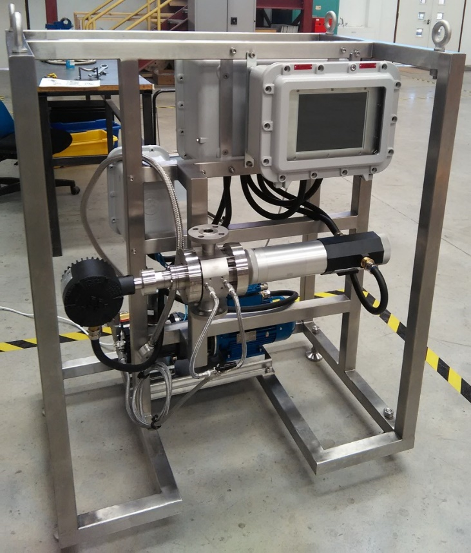
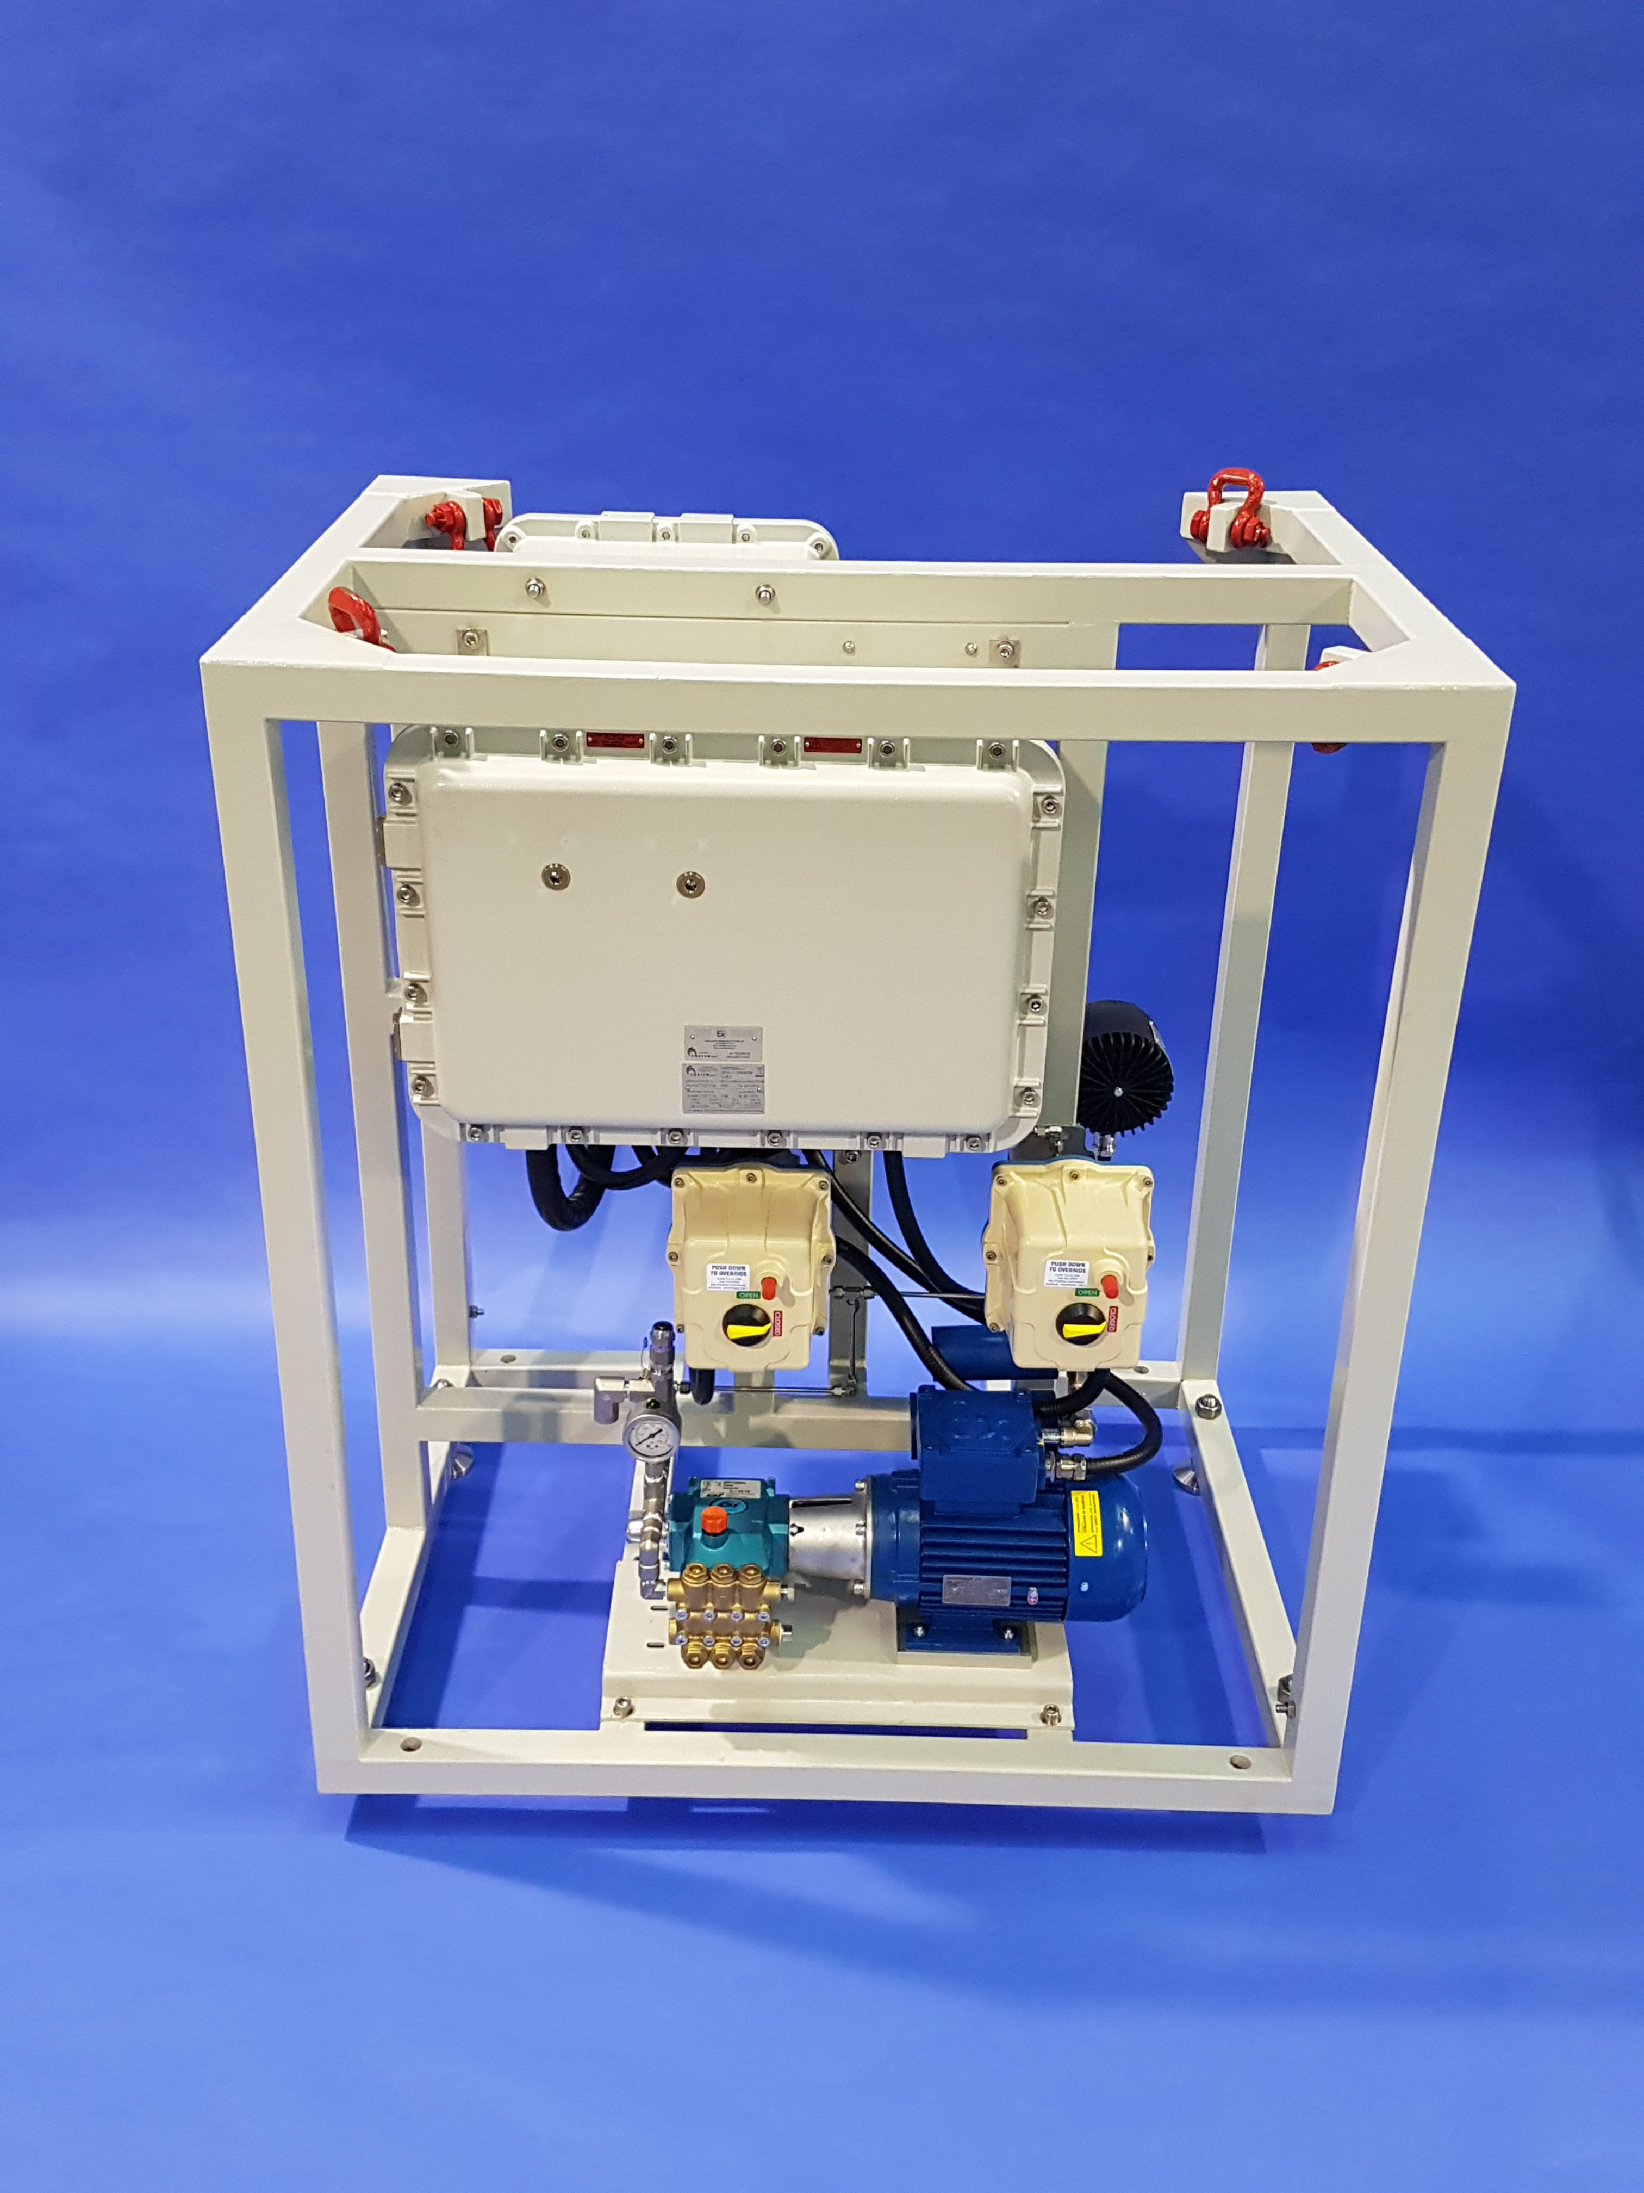
Installations – Skid
Allows for full control of cleaning system
Can be an all-in-one installation for VCM, cleaning, power supply, and analyzer
Can be integrated with in-line and at-line systems
JM Canty, Inc. · Buffalo, New York · Phone: (716) 625-4227 | JM Canty, Ltd. · Dublin, Ireland · Phone: +353 (1) 882-9621

Slide 14
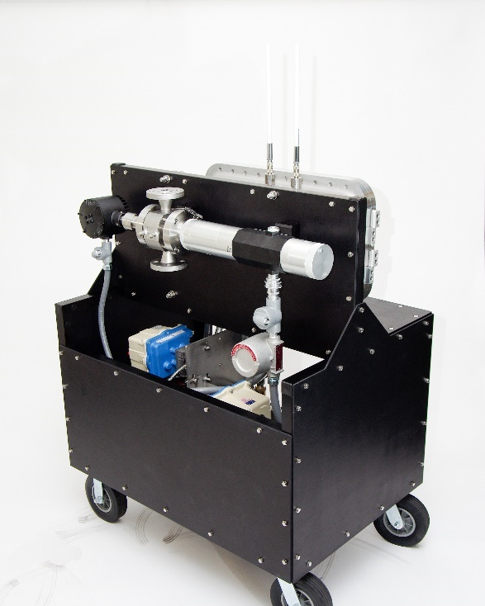
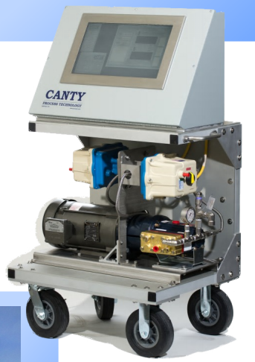
Installations - Cart
Long-term temporary testing
Mobile system
Includes cleaning pump
Functionally a skid system on wheels
JM Canty, Inc. · Buffalo, New York · Phone: (716) 625-4227 | JM Canty, Ltd. · Dublin, Ireland · Phone: +353 (1) 882-9621

Slide 15
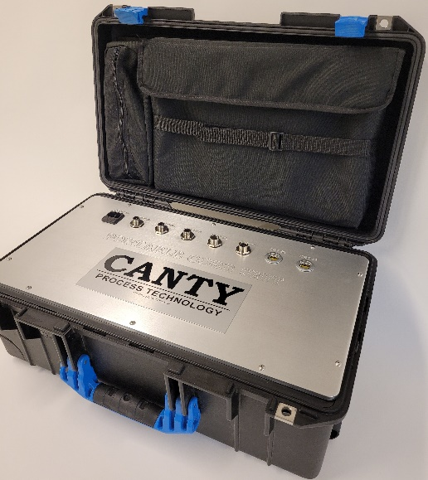
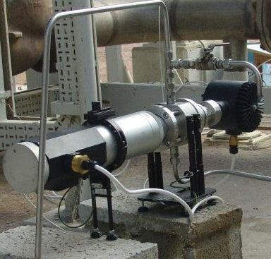
Installations – Portable
Short-term temporary testing
Easy to transport
General purpose
Analysis hardware built in PSU
JM Canty, Inc. · Buffalo, New York · Phone: (716) 625-4227 | JM Canty, Ltd. · Dublin, Ireland · Phone: +353 (1) 882-9621

Slide 16
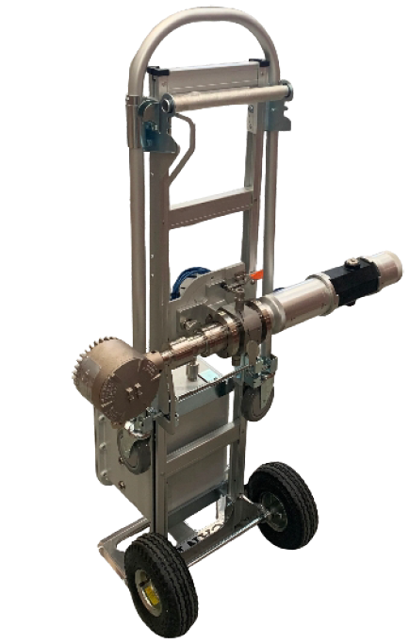
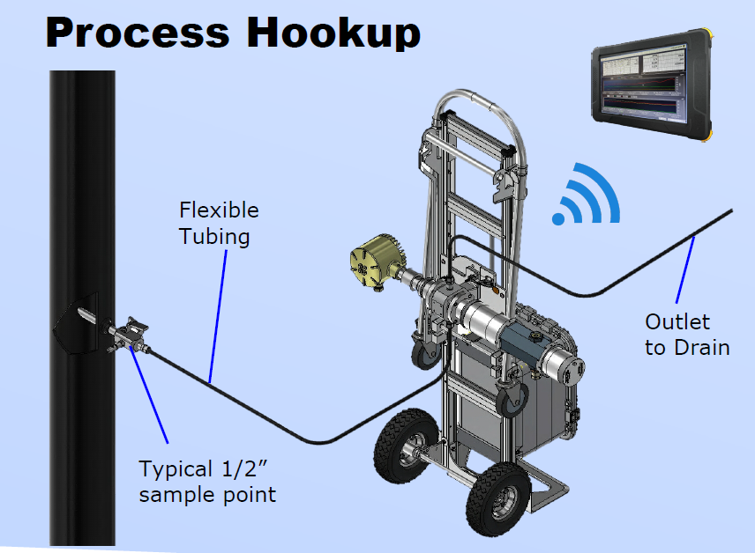
Installations - Transportable
Short-term temporary testing
ATEX rated
Easy to move from sample point to sample point
VCM built into unit, accessed via ATEX tablet
JM Canty, Inc. · Buffalo, New York · Phone: (716) 625-4227 | JM Canty, Ltd. · Dublin, Ireland · Phone: +353 (1) 882-9621

Slide 17
Installations - Lab
Same technology applied for offline samples
Smaller flow cell for smaller sample volumes
Screen, VCM, and power supply all built into one unit
CSV file reports
JM Canty, Inc. · Buffalo, New York · Phone: (716) 625-4227 | JM Canty, Ltd. · Dublin, Ireland · Phone: +353 (1) 882-9621

Slide 18


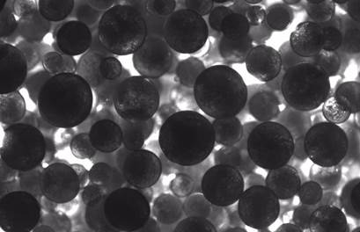
Example OIW Concentration Images
OIW < 0.5%
OIW 2%
OIW 40%
JM Canty, Inc. · Buffalo, New York · Phone: (716) 625-4227 | JM Canty, Ltd. · Dublin, Ireland · Phone: +353 (1) 882-9621

Slide 19
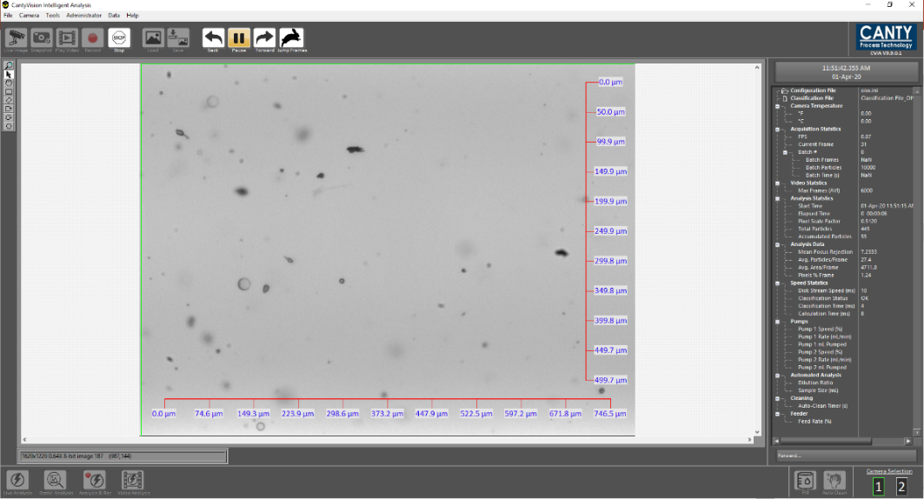
Software – Image Analysis
CantyVision Intelligent Analysis (CVIA)
Easy to use interface
Real time analysis
Video analysis options
Reports PSSD’s (particle size and shape distributions), concentrations
JM Canty, Inc. · Buffalo, New York · Phone: (716) 625-4227 | JM Canty, Ltd. · Dublin, Ireland · Phone: +353 (1) 882-9621

Slide 20
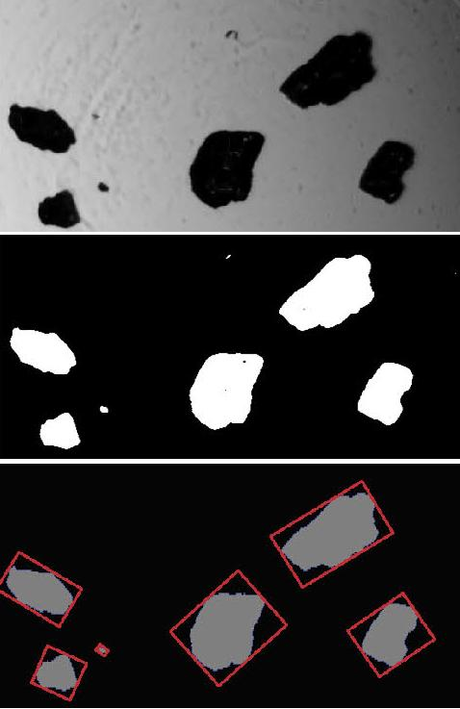
Software – Image Analysis
How does it work?
For each image in the analysis:
Distinguish background from “particles”
Throw out anything that is out of focus
Measure shape and size parameters of each particle
Determine the particle “class”
  Solid, oil droplet, gas bubble, etc…
Compile measurements (size, volume, etc…)
Update results
JM Canty, Inc. · Buffalo, New York · Phone: (716) 625-4227 | JM Canty, Ltd. · Dublin, Ireland · Phone: +353 (1) 882-9621

Slide 21
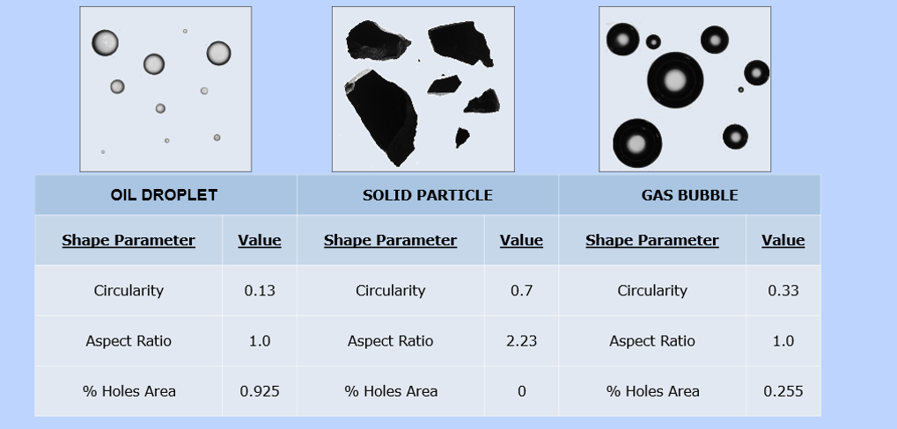
Software – Image Analysis
Differentiating between Solids, Droplets, and Bubbles
Based on particle morphology solid particles, oil droplets, and gas bubbles can all be distinguished by Canty software based on the direct 2D images.
Originally accomplished using a small number of shape parameters
Now accomplished via machine learning
JM Canty, Inc. · Buffalo, New York · Phone: (716) 625-4227 | JM Canty, Ltd. · Dublin, Ireland · Phone: +353 (1) 882-9621

Slide 22
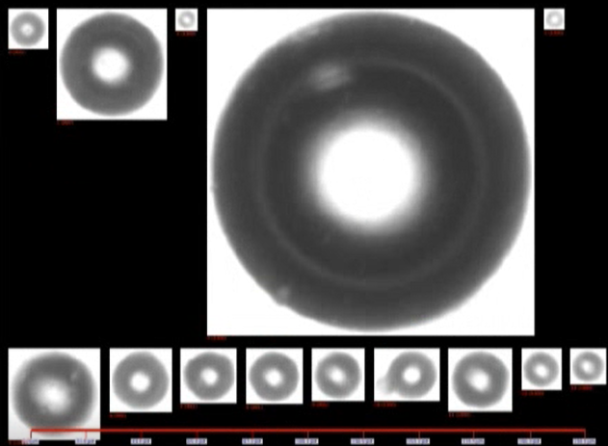
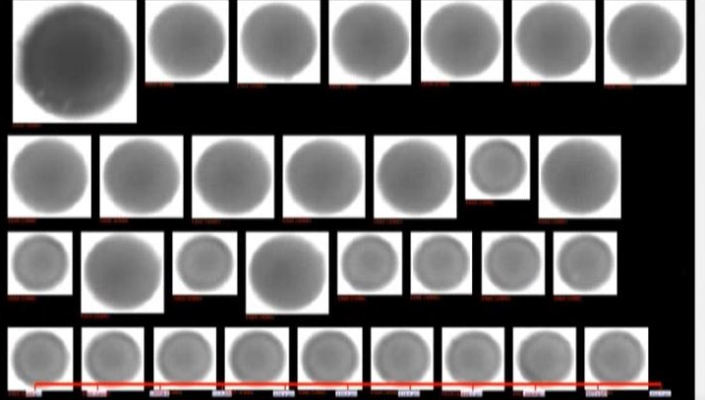
Software – Image Analysis
Differentiating between Solids, Droplets, and Bubbles
Gas Bubbles
Solids
Droplets
Example particle images trained into software
40+ shape and size parameter trends analyzed
System self classifies removing operator error
JM Canty, Inc. · Buffalo, New York · Phone: (716) 625-4227 | JM Canty, Ltd. · Dublin, Ireland · Phone: +353 (1) 882-9621

Slide 23
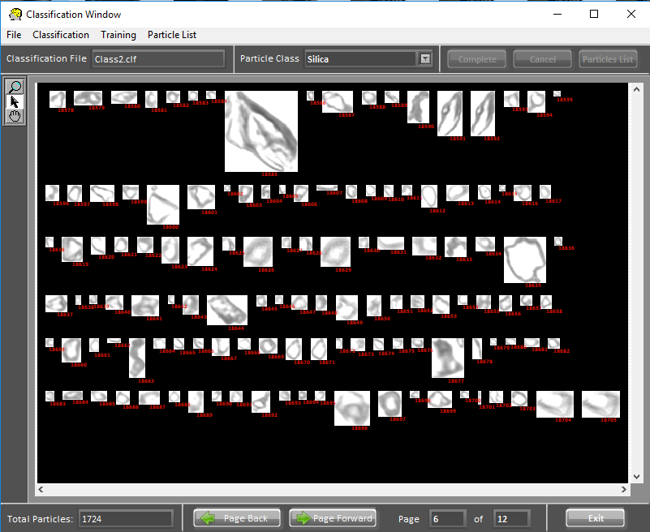
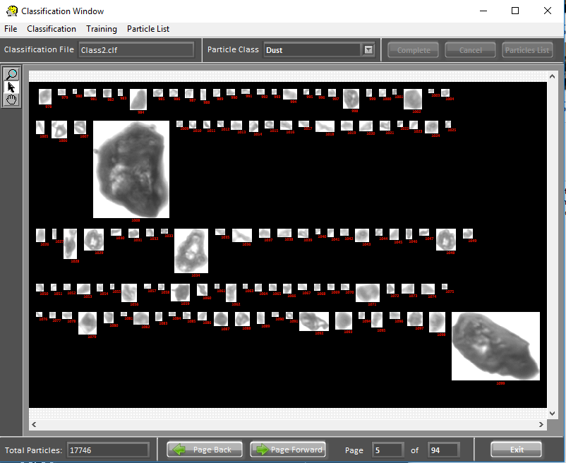
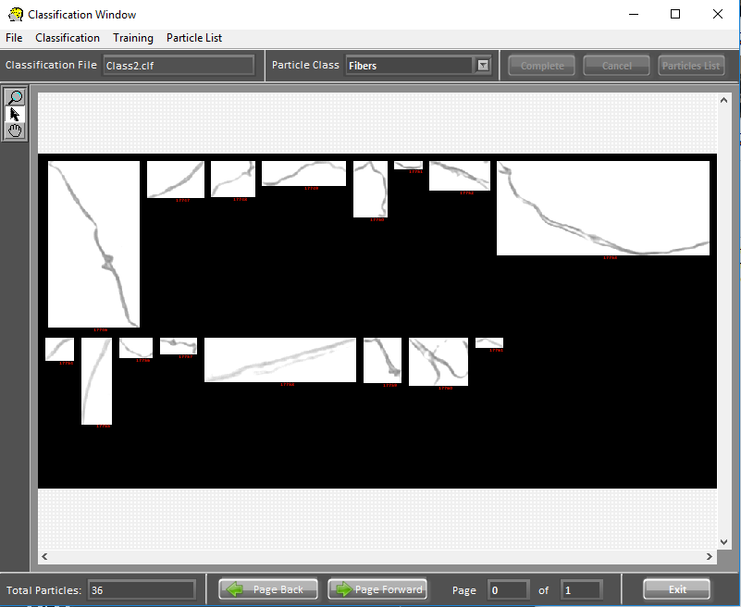
Software – Image Analysis
Differentiating between Solids, Droplets, and Bubbles
Easy to build in multiple custom classes for specific R&D
Intuitive GUI allows user to click on particles within the class they want to measure and sort particles by their individual classes.
JM Canty, Inc. · Buffalo, New York · Phone: (716) 625-4227 | JM Canty, Ltd. · Dublin, Ireland · Phone: +353 (1) 882-9621

Slide 24
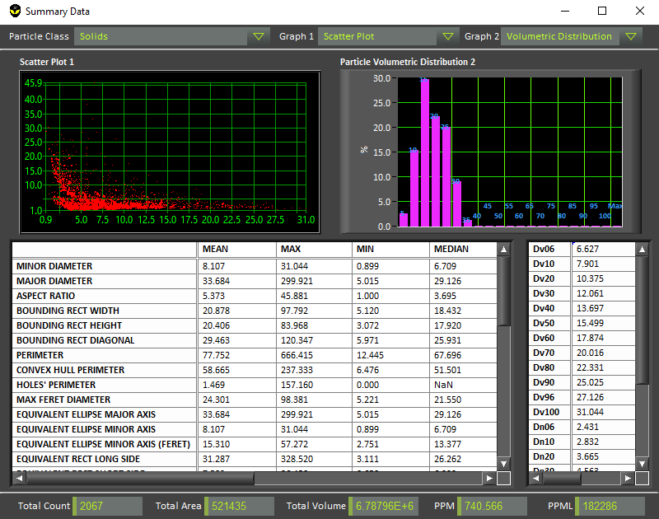
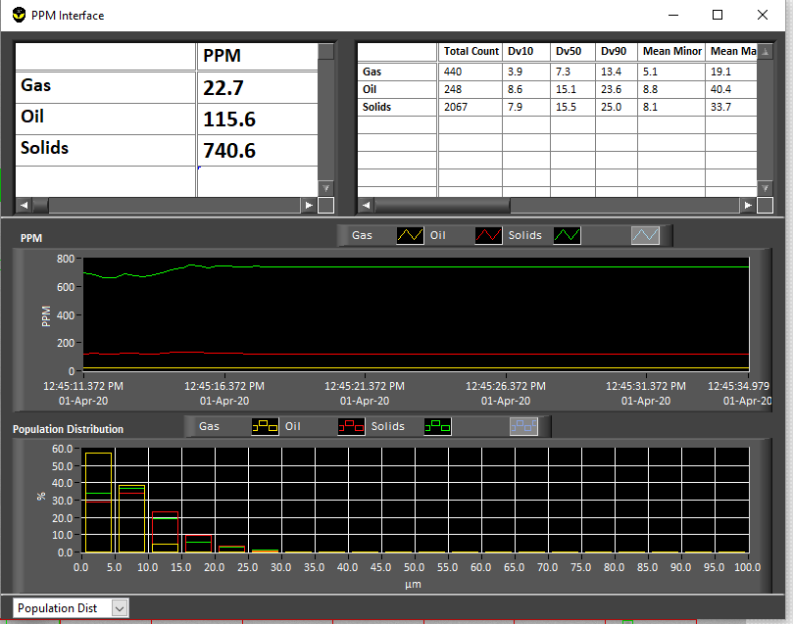
Image Analysis – Outputs
Real time PSSA, concentration display
  Percentiles
  Binned Distributions
  PPM
  PPML
Local CSV Report Outputs
Outputs can be sent via 4-20mA, Modbus TCP/IP, OPC UA, and others
JM Canty, Inc. · Buffalo, New York · Phone: (716) 625-4227 | JM Canty, Ltd. · Dublin, Ireland · Phone: +353 (1) 882-9621

Slide 25
EPA Standard – Oil in Water
  EPA Method 1664, Revision B: n-Hexane Extractable Material (HEM; Oil and Grease) and Silica Gel Treated n-Hexane Extractable Material (SGT-HEM; Non-polar Material) by Extraction and Gravimetry
  Serves the industry well for offline samples
  Nothing currently available online – we see this as an important need
  Imaging seems to be the obvious choice to move forward
JM Canty, Inc. · Buffalo, New York · Phone: (716) 625-4227 | JM Canty, Ltd. · Dublin, Ireland · Phone: +353 (1) 882-9621

Slide 26
Case Study 1: Survey of Produced Water Plant
Objectives were to assess;
droplet shearing effect of Booster Pumps and Liquid Cylinder Valve
equipment performance for removal of oil droplets of varying size
effectiveness of coalescing chemical dosing
Test | Description
1 | Upstream & Downstream of Booster Pumps with Chemical Dosing
2 | Upstream & Downstream of Booster Pumps without Chemical Dosing
3 | Upstream & Downstream of Hydrocyclone with Chemical Dosing
4 | Upstream & Downstream of Hydrocyclone without Chemical Dosing
5 | Upstream & Downstream of LCV with Chemical Dosing
6 | Upstream & Downstream of LCV without Chemical Dosing
7 | Upstream & Downstream of CFU with Chemical Dosing
8 | Upstream & Downstream of CFU without Chemical Dosing
JM Canty, Inc. · Buffalo, New York · Phone: (716) 625-4227 | JM Canty, Ltd. · Dublin, Ireland · Phone: +353 (1) 882-9621

Slide 27
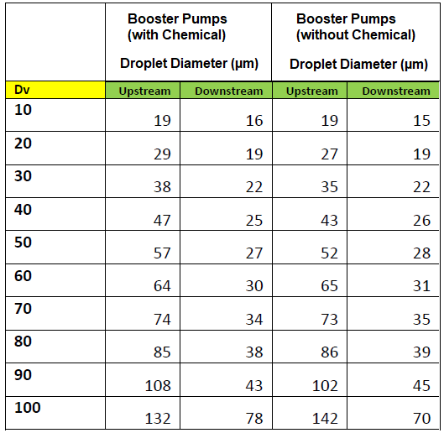
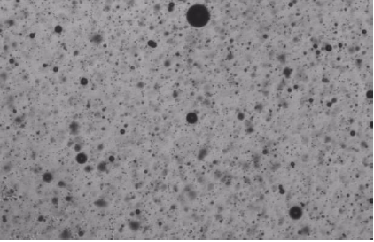
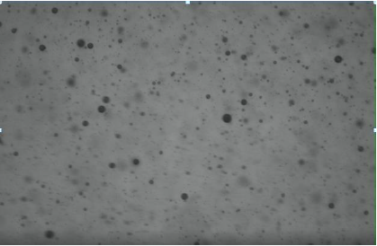
- Reduction in droplet size downstream vs upstream - pump shearing droplets
- Chemical dosing shown to have little influence on droplet size
JM Canty, Inc. · Buffalo, New York · Phone: (716) 625-4227 | JM Canty, Ltd. · Dublin, Ireland · Phone: +353 (1) 882-9621

Slide 28
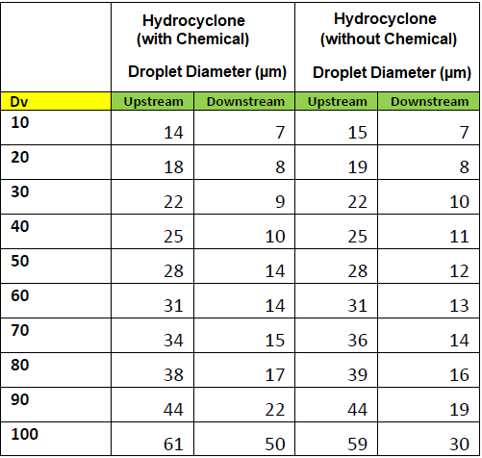

- Reduction in droplet size downstream vs upstream as expected
- Chemical dosing shown to have little influence on droplet size
JM Canty, Inc. · Buffalo, New York · Phone: (716) 625-4227 | JM Canty, Ltd. · Dublin, Ireland · Phone: +353 (1) 882-9621

Slide 29
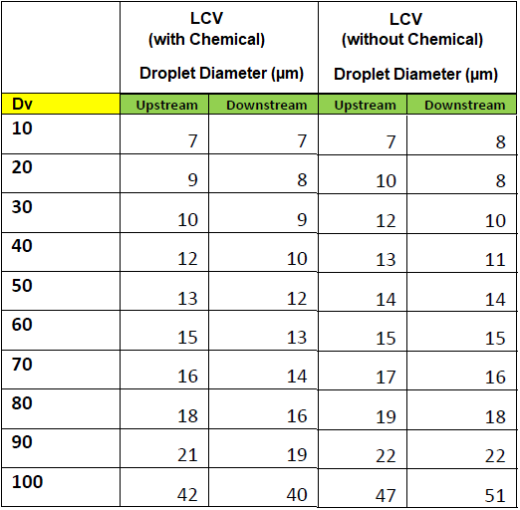
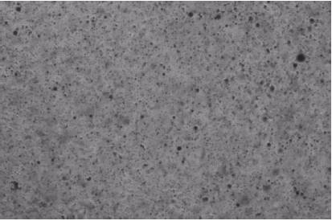
- No notable reduction in droplet size (no shearing) downstream vs upstream
- Chemical dosing shown to have little influence on droplet size
JM Canty, Inc. · Buffalo, New York · Phone: (716) 625-4227 | JM Canty, Ltd. · Dublin, Ireland · Phone: +353 (1) 882-9621

Slide 30
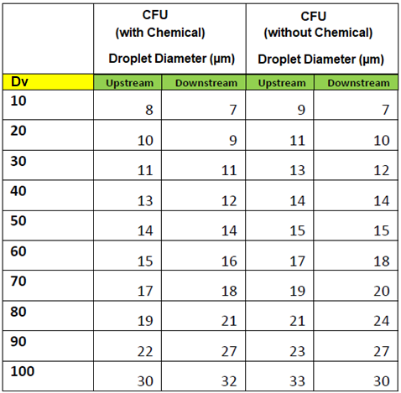

- No notable reduction in droplet size downstream vs upstream
- Chemical dosing shown to have little influence on droplet size
JM Canty, Inc. · Buffalo, New York · Phone: (716) 625-4227 | JM Canty, Ltd. · Dublin, Ireland · Phone: +353 (1) 882-9621

Slide 31
Case Study 2: Survey of an IGF & Nutshell Filter
The Canty Portable InFlow unit was connected to 3 different sampling points to determine if the inlet / outlet oil & solids were within specification;
IGF Inlet
IGF Outlet / Filter Inlet
Filter Outlet (Discharge Water)
JM Canty, Inc. · Buffalo, New York · Phone: (716) 625-4227 | JM Canty, Ltd. · Dublin, Ireland · Phone: +353 (1) 882-9621

Slide 32
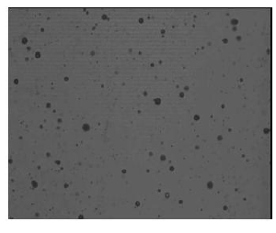
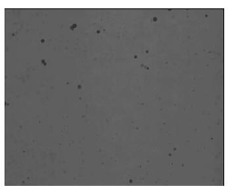
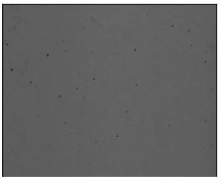
Case Study 2: Oil in Water
Dynamic Imaging Applied to IGF & Filtration Performance Analysis
IGF Inlet IGF Outlet / Filter Inlet Filter Outlet
JM Canty, Inc. · Buffalo, New York · Phone: (716) 625-4227 | JM Canty, Ltd. · Dublin, Ireland · Phone: +353 (1) 882-9621

Slide 33
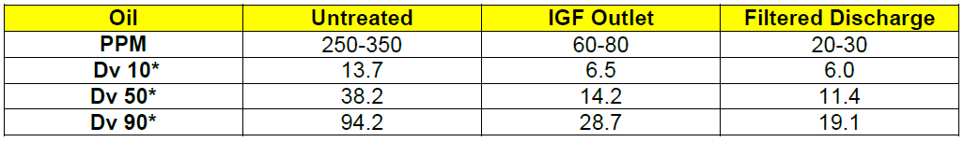
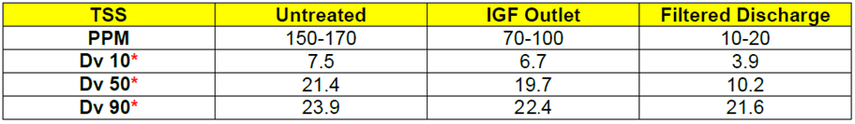
Case Study 2: Survey of an IGF & Nutshell Filter
JM Canty, Inc. · Buffalo, New York · Phone: (716) 625-4227 | JM Canty, Ltd. · Dublin, Ireland · Phone: +353 (1) 882-9621

Slide 34
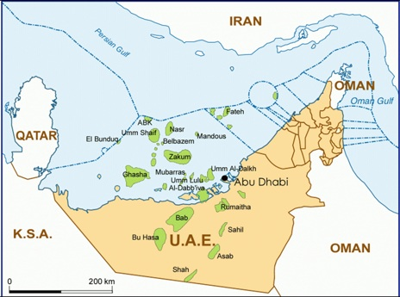
Case Study 3: Sand / TSS in WFI
Bu Hasa Field UAE, 200km SW of Abu Dhabi
Approximately 700 wells in total, with approximately 300 injection wells
Injection water is primarily taken from separate water supply well, some produced water injected also
Portable Inflow installed at sample points for approximately 2 hrs at a time
Real time results obtained compared with operator’s offline lab method
JM Canty, Inc. · Buffalo, New York · Phone: (716) 625-4227 | JM Canty, Ltd. · Dublin, Ireland · Phone: +353 (1) 882-9621

Slide 35
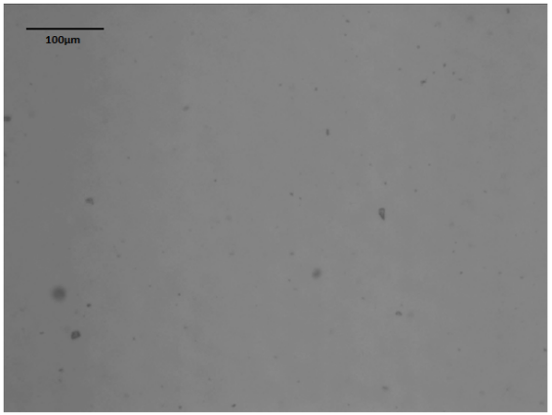
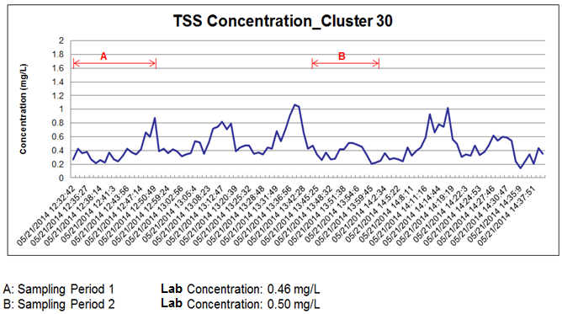
Case Study 3: Sand / TSS in WFI
TSS Size Data
Dv | Size (µm)
10 | 2.7
20 | 3.5
30 | 3.9
40 | 4.7
50 | 5.1
60 | 5.6
70 | 6.0
80 | 6.9
90 | 8.1
100 | 11.8
Sample Point 1: Cluster 30
TSS Shape Data (Aspect Ratio)
Dv
10 | 1.19
20 | 1.27
30 | 1.33
40 | 1.40
50 | 1.51
60 | 1.61
70 | 1.69
80 | 1.76
90 | 1.88
100 | 2.84
JM Canty, Inc. · Buffalo, New York · Phone: (716) 625-4227 | JM Canty, Ltd. · Dublin, Ireland · Phone: +353 (1) 882-9621

Slide 36
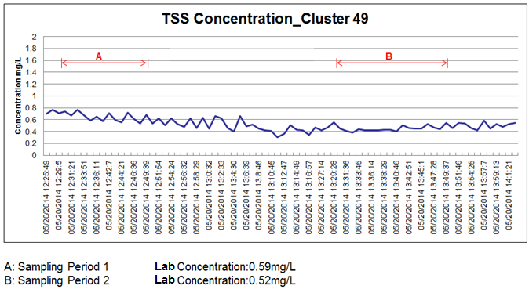
Case Study 3: Sand / TSS in WFI
TSS Size Data
Dv | Size (µm)
10 | 2.6
20 | 3.2
30 | 3.9
40 | 4.5
50 | 4.9
60 | 5.3
70 | 5.9
80 | 6.5
90 | 7.4
100 | 9.4
Sample Point 2: Cluster 49
TSS Shape Data (Aspect Ratio)
Dv
10 | 1.27
20 | 1.30
30 | 1.36
40 | 1.44
50 | 1.52
60 | 1.59
70 | 1.68
80 | 1.74
90 | 1.84
100 | 2.69
JM Canty, Inc. · Buffalo, New York · Phone: (716) 625-4227 | JM Canty, Ltd. · Dublin, Ireland · Phone: +353 (1) 882-9621

Slide 37

Case Study 3: Sand / TSS in WFI
TSS Size Data
Dv | Size (µm)
10 | 2.7
20 | 3.9
30 | 3.9
40 | 5.1
50 | 5.8
60 | 6.3
70 | 7.1
80 | 9.1
90 | 12.8
100 | 14.8
Sample Point 3: Cluster 51
TSS Shape Data (Aspect Ratio)
Dv
10 | 1.24
20 | 1.28
30 | 1.33
40 | 1.39
50 | 1.45
60 | 1.60
70 | 1.59
80 | 1.73
90 | 1.88
100 | 3.33
JM Canty, Inc. · Buffalo, New York · Phone: (716) 625-4227 | JM Canty, Ltd. · Dublin, Ireland · Phone: +353 (1) 882-9621

Slide 38

Questions
&
Answers
JM Canty, Inc. · Buffalo, New York · Phone: (716) 625-4227 | JM Canty, Ltd. · Dublin, Ireland · Phone: +353 (1) 882-9621

